Slide 1


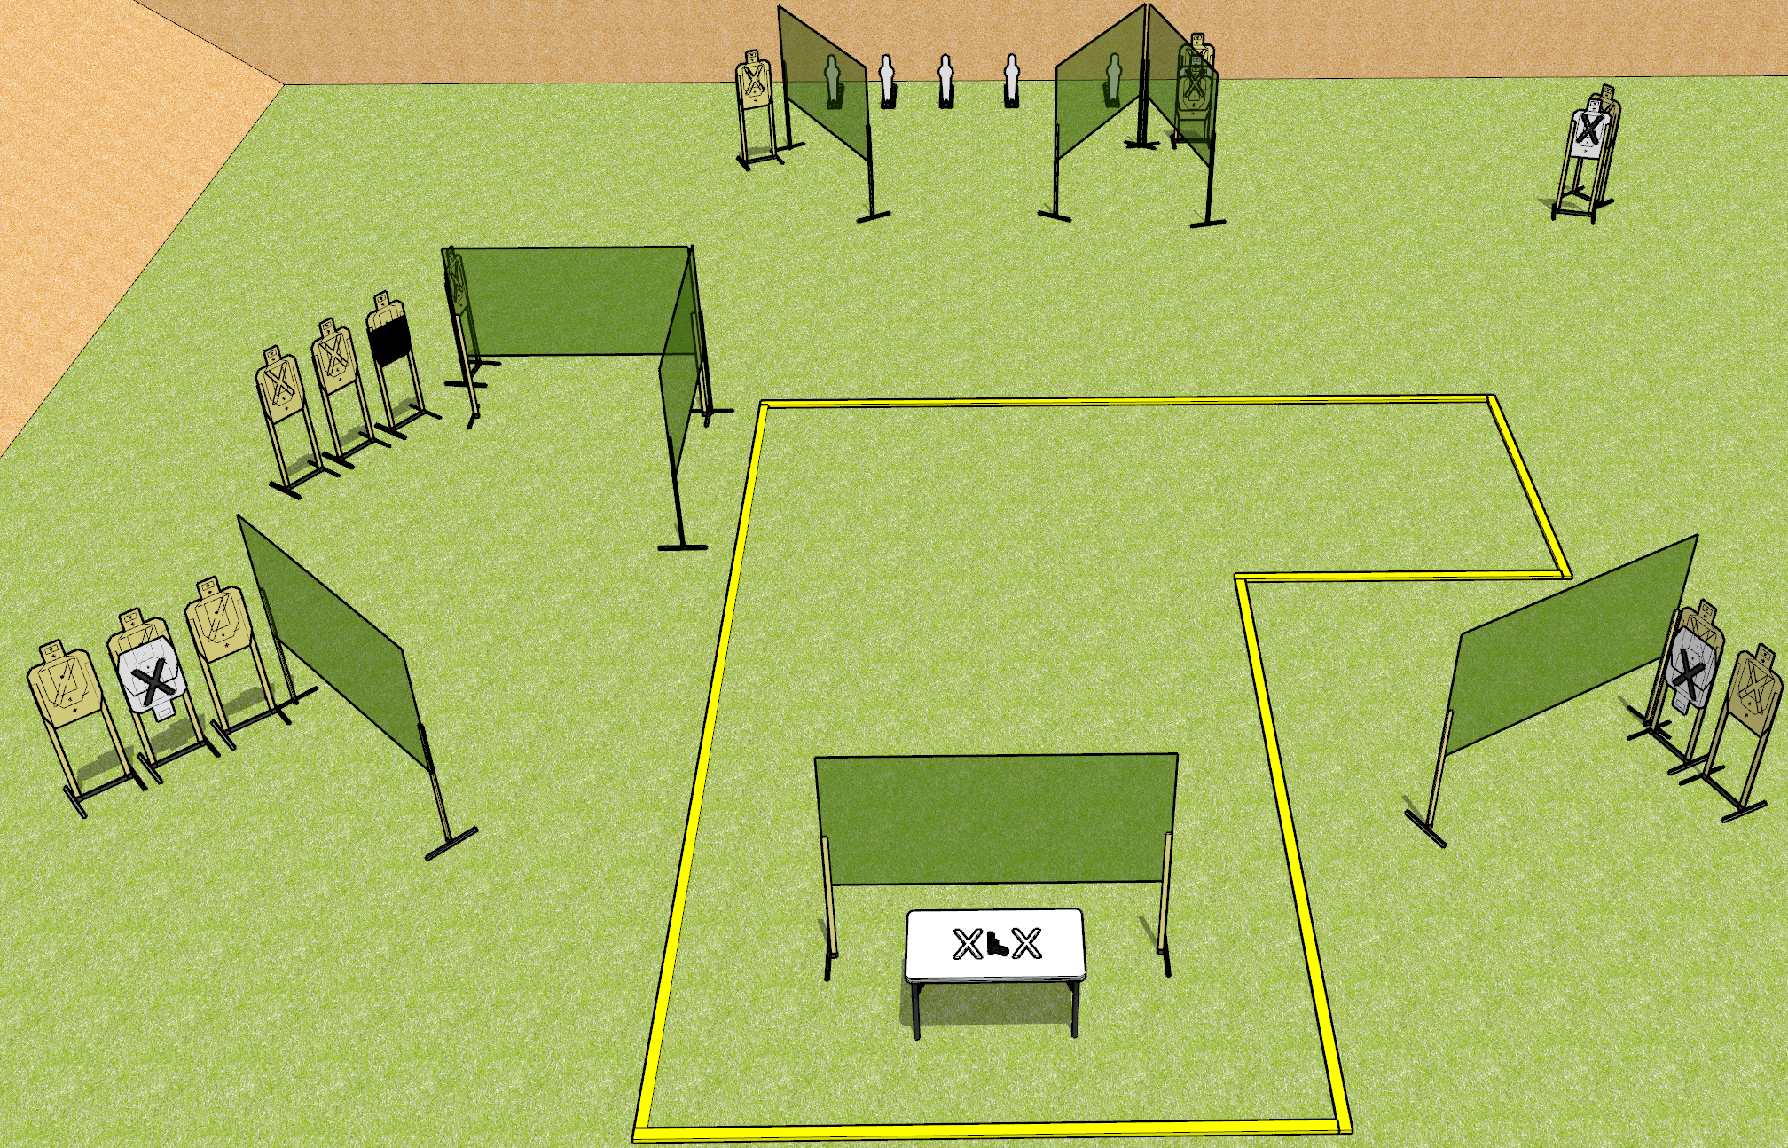
 | Dothan Gun Club – USPSA Match Horsing Around Course Designer : Drew Coleman
START POSITION : Standing with both hands palms flat covering X’s on table.
GUN READY CONDITION : Firearm loaded, safety on, pointed squarely down range, trigger guard on mark. |  | SCORING: Comstock, 31 rounds TARGETS: 13 paper, 5 Steel SCORED HITS: Best 2 on paper, steel until down START-STOP: Audible, last shot RULES:
STAGE PROCEDURE: Engage targets as they become available from within the fault lines.

Slide 2
Horsing Around
Written Stage Briefing
Horsing Around is a 31 round, 155 point, Comstock Long Course. There are thirteen USPSA targets and five mini-poppers. The best two hits on paper will score and steel must fall to score. The start signal is audible.
Handgun start position is with both hands covering marks with palms. Handgun is loaded, lying unsupported on table, with trigger guard on mark. Muzzle must be pointed squarely down range.
Handgun start position is with both hands covering marks with palms. Carbine is loaded, safety on, lying unsupported on table, with trigger guard on mark. Muzzle must be pointed squarely down range.
Upon start signal, engage targets as they become available from within the fault lines.

